Slide 1
Chongqing University of Technology
ATAI
Advanced Technique of Artificial Intelligence
Chongqing University of Technology
Lu Xu^{* 1, 2}, Lidong Bing², Wei Lu¹, Fei Huang²
¹StatNLP Research Group, Singapore University of Technology and Design
²DAMO Academy, Alibaba Group
Aspect Sentiment Classification with Aspect-Specific Opinion Spans
——EMNLP 2020
Code：https://github.com/xuuuluuu/Aspect-Sentiment-Classification
2020.12.07 • ChongQing
Reported by Sijin Liu

Slide 2
Chongqing University of Technology
ATAI
Advanced Technique of Artificial Intelligence
Chongqing University of Technology
1.Introduction
2.Method
3.Experiments
4.Conclusion

Slide 3
Introduction
Aspect Sentiment Classification
“I bought a new camera. The picture quality is amazing but the battery life is too short.”
Aspect：picture quality
Polarity：positive
Aspect：battery life
Polarity：negative
Notes:
Aspect：picture quality
Polarity：positive
Aspect：battery life
Polarity：negative

Slide 4
Introduction
Relative work
（1）Most of the previous works adopt attention mechanism to capture the semantic relatedness among the context words and the aspect, and learn aspect-specific features for sentiment classification.
（2）It is challenging for attention-based approaches to consider an opinion span as a whole during feature extraction.
（3）To better capture opinion features for aspect sentiment classification, we propose the MCRF-SA model, which introduces multiple conditional random fields (CRF) to structured attention model.

Slide 5
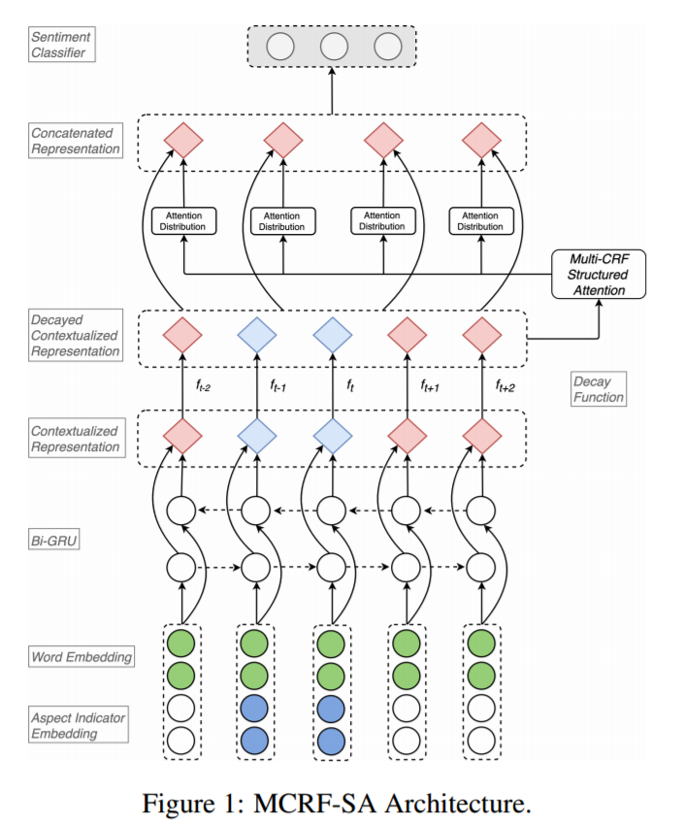
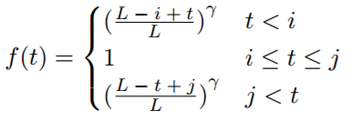
Method
context sequence：
aspect sequence：
predict sentiment polarity：
$$y ∈ \{positive, negative, neutral\}$$

Slide 6
Method
latent label：
transition score
emission score

Slide 7
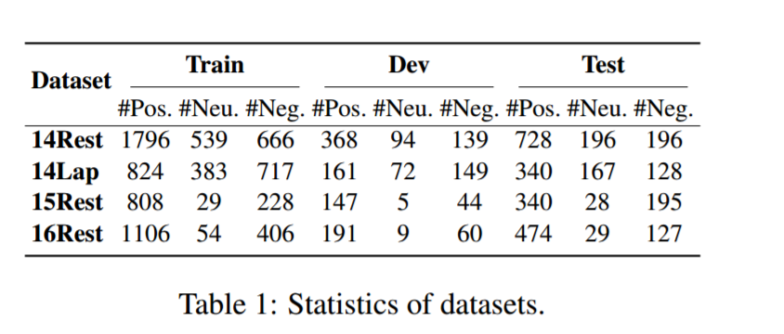
Experiments

Slide 8
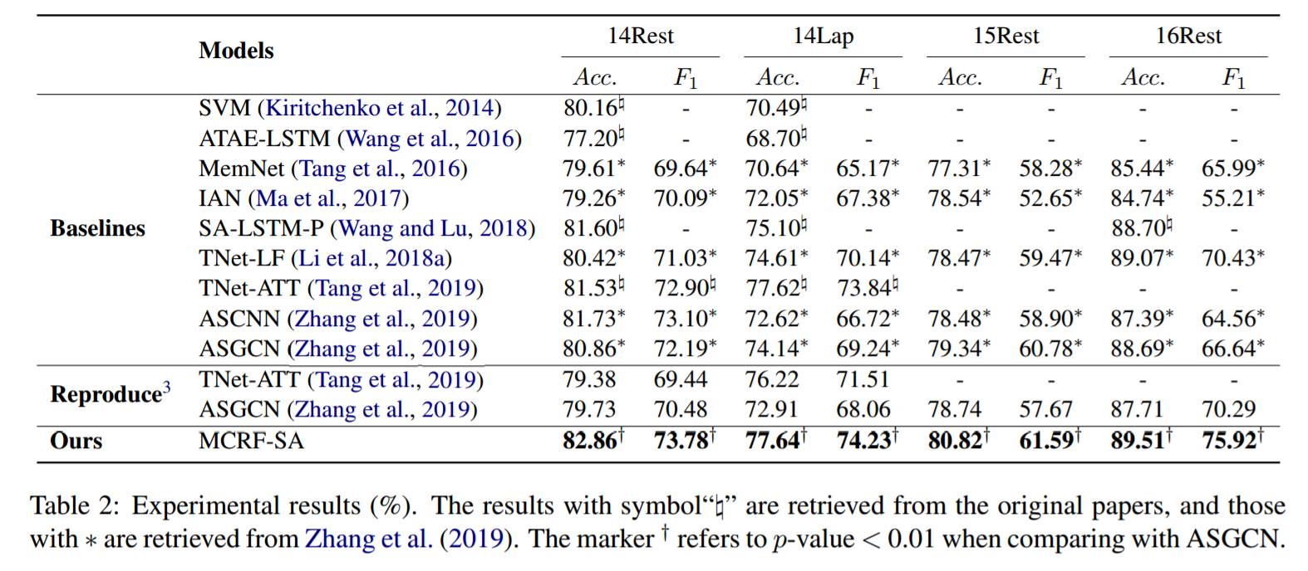
Experiments

Slide 9
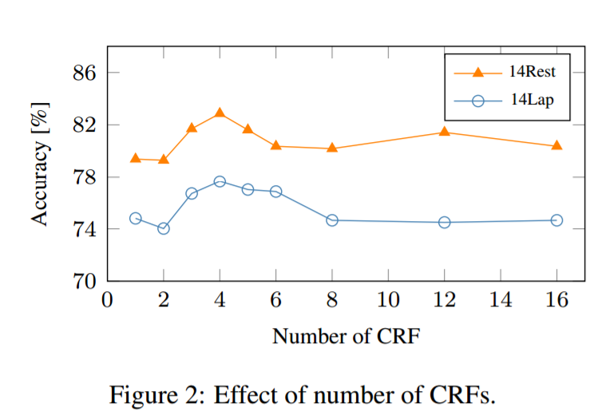
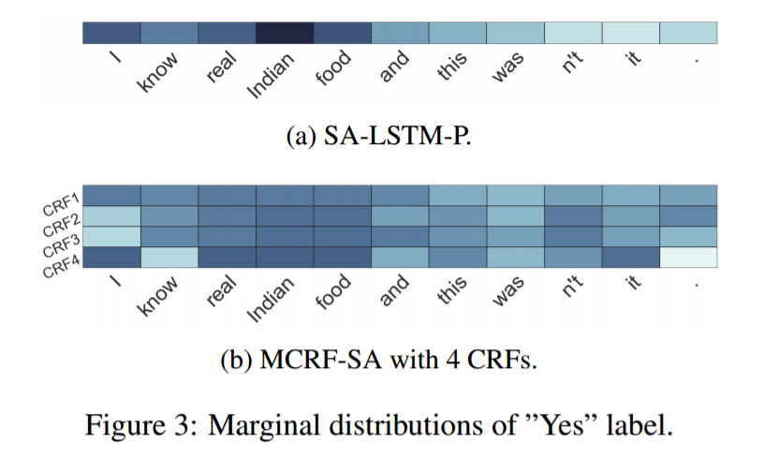
Experiments

Slide 10
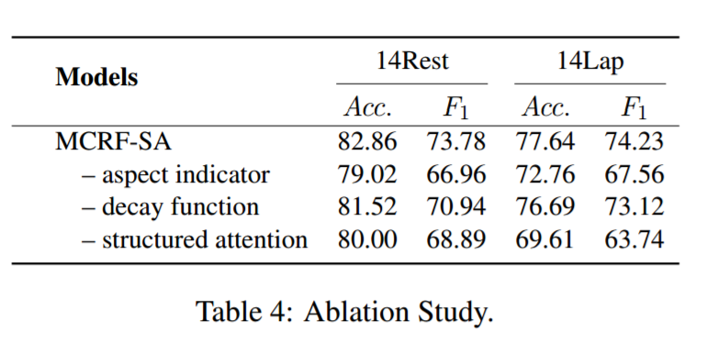
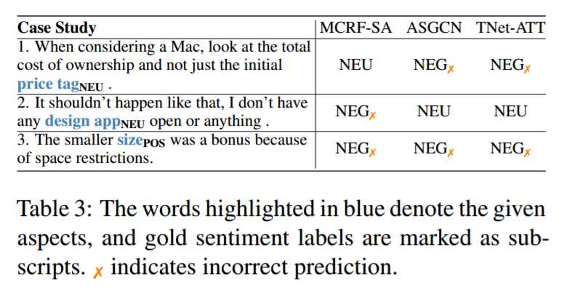
Experiments

Slide 11
Summary
This work proposed a simple and effective MCRF-SA model to extract aspect-specific opinion span features. In particular, with the proposed multi-CRF structured attention layer and the effective position decay function, our model is capable of extracting various aspect-specific opinion span features from different representation sub-spaces. The experimental results demonstrate that our method effectively exploits the corresponding opinion features for sentiment classification. One future direction is to investigate how to integrate the two different attention mechanisms, namely the standard attention and structured attention for NLP applications..

Slide 12
Thank you!

Slide 13
